Slide 1


Slide 2
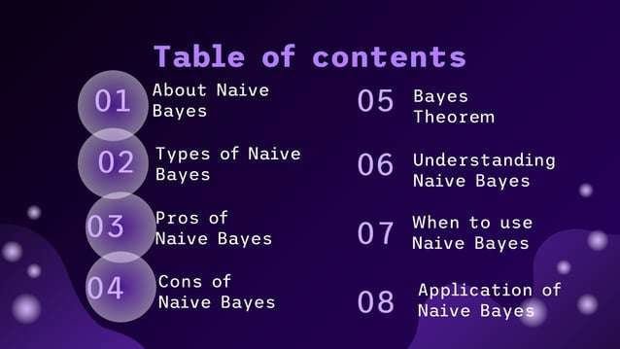

Slide 3
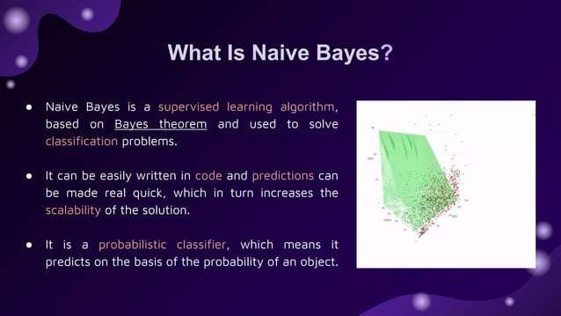

Slide 4
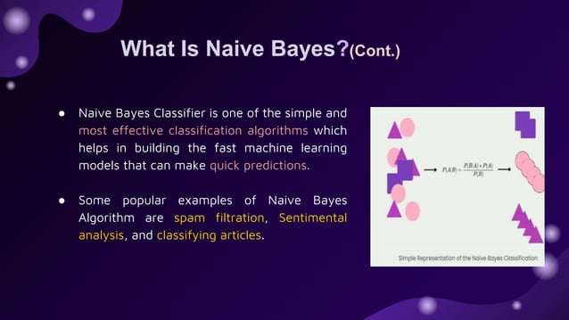

Slide 5
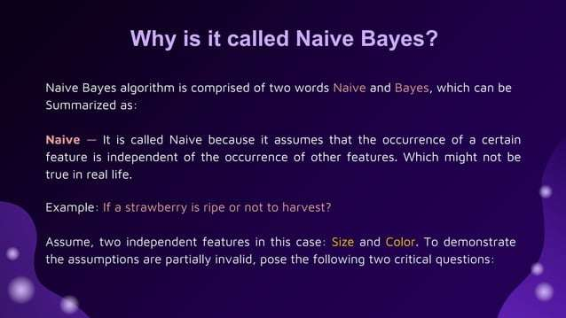

Slide 6
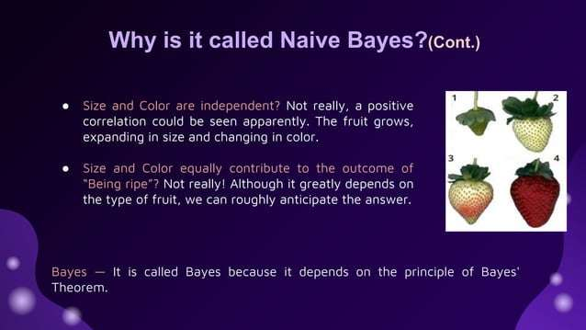

Slide 7
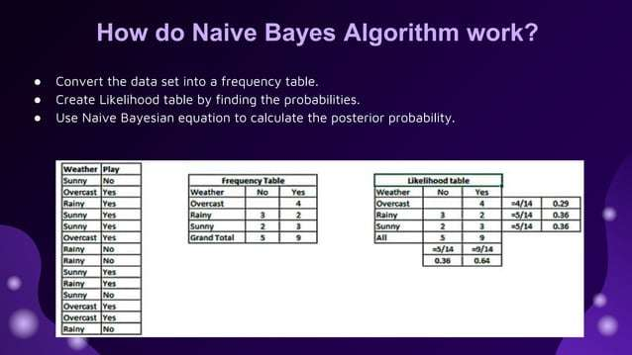

Slide 8
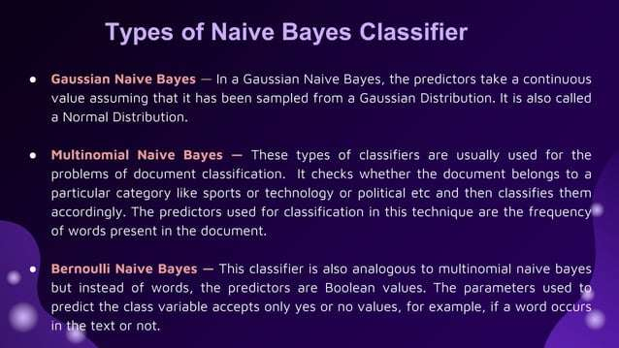

Slide 9
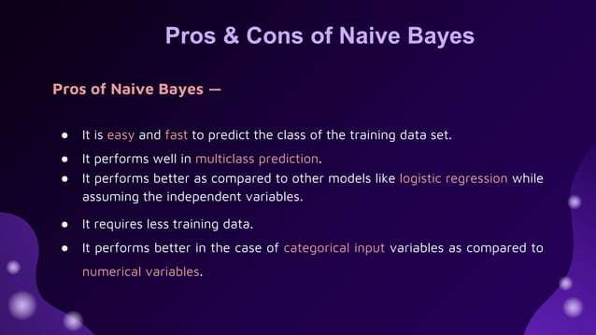

Slide 10
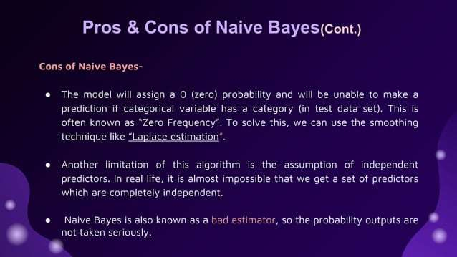

Slide 11
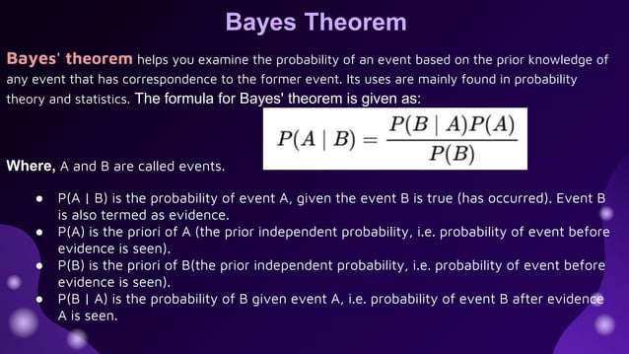

Slide 12
Naive Bayes Example (Buying a Computer)
Problem:
You are given some past customer data about Age, Income, and whether they bought a computer (Yes or No). Now, a new customer is Young and has Medium income.
You need to predict: Will they buy a computer?

Slide 13
Problem: Predict if a person will buy a computer based on Age and Income.
Person | Age | Income | Buys Computer
1 | Young | High | No
2 | Young | High | No
3 | Middle | High | Yes
4 | Senior | Medium | Yes
5 | Senior | Low | Yes
6 | Senior | Low | No
7 | Middle | Low | Yes
8 | Young | Medium | No
9 | Young | Low | Yes
10 | Senior | Medium | Yes
11 | Young | Medium | Yes
12 | Middle | Medium | Yes
13 | Middle | High | Yes
14 | Senior | Medium | No

Slide 14

Step-by-Step Breakdown
1. Prior Probabilities
First, we need to know how likely overall customers buy or not buy.
From the table:
9 customers said Yes (they bought a computer).
5 customers said No.
So:
This means that, without any extra information, buying is more common.

Slide 15

2. Likelihood Probabilities
Now we use the new customer’s features (Young, Medium) to update our prediction.
We calculate:
How often Young people bought / did not buy.
How often Medium Income people bought / did not buy.
For Age = Young
Among customers who bought (Yes), 2 of them were Young.
Among customers who did not buy (No), 3 were Young.
Calculations:
🔵 So if you bought, you were Young only about 22% of the time. 🔴 If you didn’t buy, you were Young 60% of the time.

Slide 16
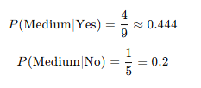
For Income = Medium
Among customers who bought (Yes), 4 had Medium income.
Among customers who did not buy (No), 1 had Medium income.
Calculations:
P(Medium∣Yes)=49≈0.444P(\text{Medium}|\text{Yes}) = \frac{4}{9} \approx 0.444
🔵 So about 44% of buyers had Medium income. 🔴 Only 20% of non-buyers had Medium income.

Slide 17
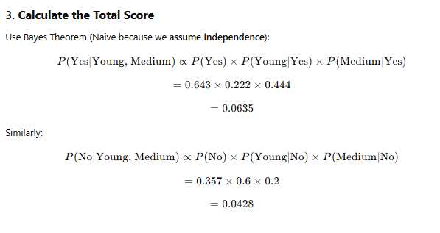

Slide 18
4. Compare
Probability of buying: 0.0635
Probability of not buying: 0.0428
✅ Since 0.0635> 0.0428, ✅ We predict: YES, the customer will buy a computer!

Slide 19
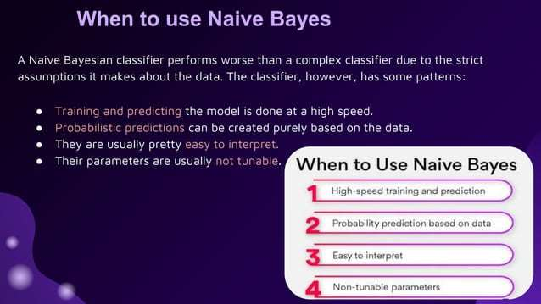

Slide 20
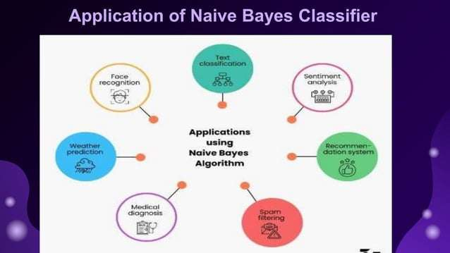

Slide 21
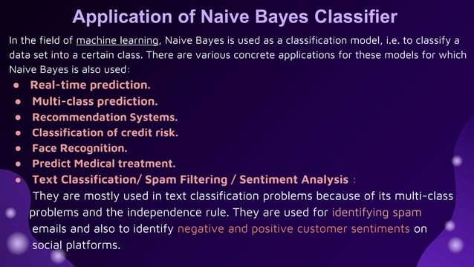

Slide 22
Home Task
Naive Bayes Example: Spam Email Detection
Problem:
You are building a simple model to predict if an email is Spam based on the presence of certain words:
Email ID | "Free" | "Win" | "Money" | Spam
1 | Yes | Yes | No | Yes
2 | Yes | No | Yes | Yes
3 | No | Yes | No | No
4 | No | No | Yes | No
5 | Yes | Yes | Yes | Yes
6 | No | Yes | Yes | No
New Email to classify:
Contains "Free" = Yes, "Win" = Yes, "Money" = No
Predict if it's Spam or Not Spam!
Python code is also required for the task with output.

Slide 23


